Slide 1
Software Modeling

Slide 2

Key Points from Previous Lectures

Slide 3
Principles that Guide Process - I
Principle #1. Be agile. Whether the process model you choose is prescriptive or agile, the basic tenets of agile development should govern your approach.
Principle #2. Focus on quality at every step. The exit condition for every process activity, action, and task should focus on the quality of the work product that has been produced.
Principle #3. Be ready to adapt. Process is not a religious experience and dogma has no place in it. When necessary, adapt your approach to constraints imposed by the problem, the people, and the project itself.
Principle #4. Build an effective team. Software engineering process and practice are important, but the bottom line is people. Build a self-organizing team that has mutual trust and respect.

Slide 4
Principles that Guide Process - II
Principle #5. Establish mechanisms for communication and coordination. Projects fail because important information falls into the cracks and/or stakeholders fail to coordinate their efforts to create a successful end product.
Principle #6. Manage change. The approach may be either formal or informal, but mechanisms must be established to manage the way changes are requested, assessed, approved and implemented.
Principle #7. Assess risk. Lots of things can go wrong as software is being developed. It’s essential that you establish contingency plans.
Principle #8. Create work products that provide value for others. Create only those work products that provide value for other process activities, actions or tasks.

Slide 5
Requirements

Slide 6
Requirements Engineering-I
Inception—ask a set of questions that establish …
basic understanding of the problem
the people who want a solution
the nature of the solution that is desired, and
the effectiveness of preliminary communication and collaboration between the customer and the developer
Elicitation—elicit requirements from all stakeholders
Elaboration—create an analysis model that identifies data, function and behavioral requirements
Negotiation—agree on a deliverable system that is realistic for developers and customers

Slide 7
Requirements Engineering-II
Specification—can be any one (or more) of the following:
A written document
A set of models
A formal mathematical
A collection of user scenarios (use-cases)
A prototype
Validation—a review mechanism that looks for
errors in content or interpretation
areas where clarification may be required
missing information
inconsistencies (a major problem when large products or systems are engineered)
conflicting or unrealistic (unachievable) requirements.
Requirements management

Slide 8
Inception
Identify stakeholders
“who else do you think I should talk to?”
Recognize multiple points of view
Work toward collaboration
The first questions
Who is behind the request for this work?
Who will use the solution?
What will be the economic benefit of a successful solution
Is there another source for the solution that you need?

Slide 9
Eliciting Requirements
meetings are conducted and attended by both software engineers and customers
rules for preparation and participation are established
an agenda is suggested
a "facilitator" (can be a customer, a developer, or an outsider) controls the meeting
a "definition mechanism" (can be work sheets, flip charts, or wall stickers or an electronic bulletin board, chat room or virtual forum) is used
the goal is
to identify the problem
propose elements of the solution
negotiate different approaches, and
specify a preliminary set of solution requirements

Slide 10
Elicitation Work Products
a statement of need and feasibility.
a bounded statement of scope for the system or product.
a list of customers, users, and other stakeholders who participated in requirements elicitation
a description of the system’s technical environment.
a list of requirements (preferably organized by function) and the domain constraints that apply to each.
a set of usage scenarios that provide insight into the use of the system or product under different operating conditions.
any prototypes developed to better define requirements.

Slide 11
Use-Cases
A collection of user scenarios that describe the thread of usage of a system
Each scenario is described from the point-of-view of an “actor”—a person or device that interacts with the software in some way
Each scenario answers the following questions:
Who is the primary actor, the secondary actor (s)?
What are the actor’s goals?
What preconditions should exist before the story begins?
What main tasks or functions are performed by the actor?
What extensions might be considered as the story is described?
What variations in the actor’s interaction are possible?
What system information will the actor acquire, produce, or change?
Will the actor have to inform the system about changes in the external environment?
What information does the actor desire from the system?
Does the actor wish to be informed about unexpected changes?

Slide 12
Use-Case Diagram

Slide 13
Negotiating Requirements
Identify the key stakeholders
These are the people who will be involved in the negotiation
Determine each of the stakeholders “win conditions”
Win conditions are not always obvious
Negotiate
Work toward a set of requirements that lead to “win-win”

Slide 14
Requirements Monitoring
Especially needed in incremental development
Run-time verification – determines whether software matches its specification.
Run-time validation – assesses whether evolving software meets user goals.
Business activity monitoring – evaluates whether a system satisfies business goals.
Evolution – provides information to stakeholders as the system evolves.

Slide 15
Validating Requirements - I
Is each requirement consistent with the overall objective for the system/product?
Have all requirements been specified at the proper level of abstraction? That is, do some requirements provide a level of technical detail that is inappropriate at this stage?
Is the requirement really necessary or does it represent an add-on feature that may not be essential to the objective of the system?
Is each requirement bounded and unambiguous?
Does each requirement have attribution? That is, is a source (generally, a specific individual) noted for each requirement?
Do any requirements conflict with other requirements?

Slide 16
Validating Requirements - II
Is each requirement achievable in the technical environment that will house the system or product?
Is each requirement testable, once implemented?
Does the requirements model properly reflect the information, function and behavior of the system to be built.
Has the requirements model been “partitioned” in a way that exposes progressively more detailed information about the system.

Slide 17
Example

Slide 18
OBJECT-ORIENTED ANALYSIS

Slide 19
Overview
Object-oriented analysis
Use-case modeling
Class modeling
Dynamic Modeling
Challenges of the object-oriented analysis phase

Slide 20
Object-Oriented Paradigm
Object consists of
Data (attributes, state variables, instance variables, fields, data members), and
Actions (methods, member functions)
Objects are independent units
Conceptual independence
Physical independence

Slide 21
Object-Oriented Analysis (contd)
Semi-formal specification technique
Multiplicity of different methods
Booch
OMT
Objectory
Shlaer-Mellor
Coad-Yourdon
All essentially equivalent
Nowadays, we represent OOA using UML (unified modeling language)

Slide 22
The Three Steps of OOA
1. Use-case modeling
Determine how the various results are computed by the product (without regard to sequencing)
Largely action oriented
2. Class modeling (“object modeling”)
Determine the classes and their attributes
Purely data-oriented
3. Dynamic modeling
Determine the actions performed by or to each class
Purely action-oriented
Iterative process

Slide 23
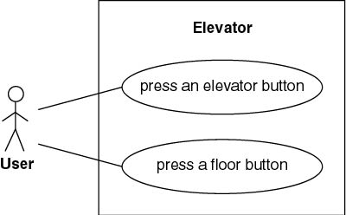
Elevator Problem: OOA
1. Use-Case Modeling
Use case: Generic description of overall functionality
Scenario: Instance of a use case
Get comprehensive insight into behavior of product

Slide 24
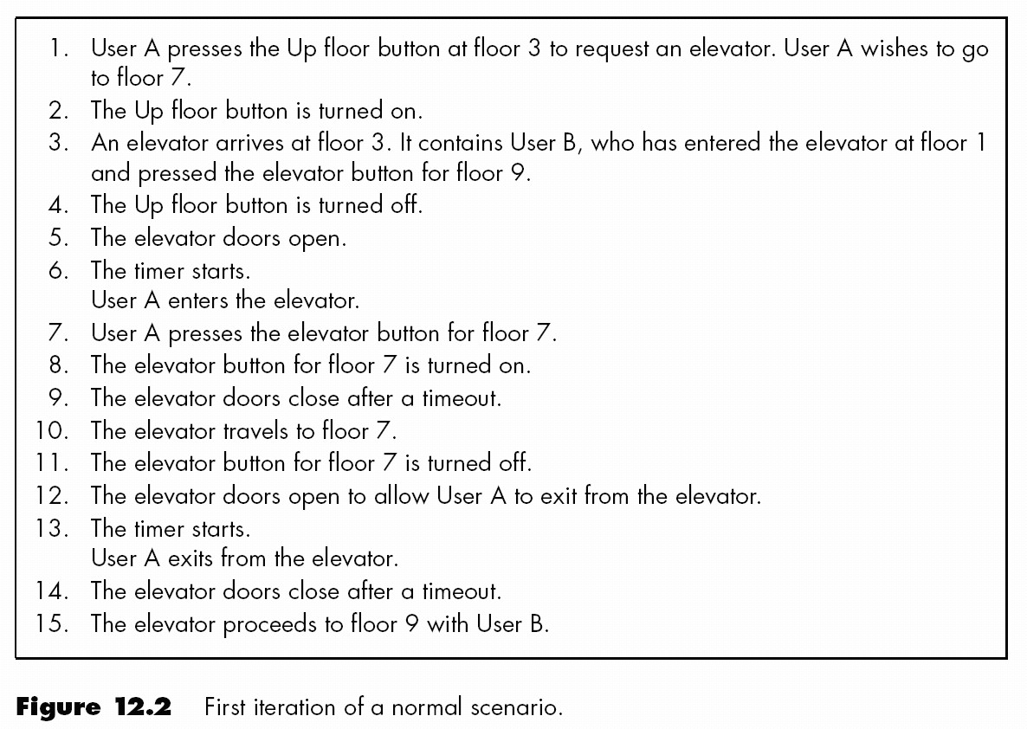
Normal Scenario

Slide 25
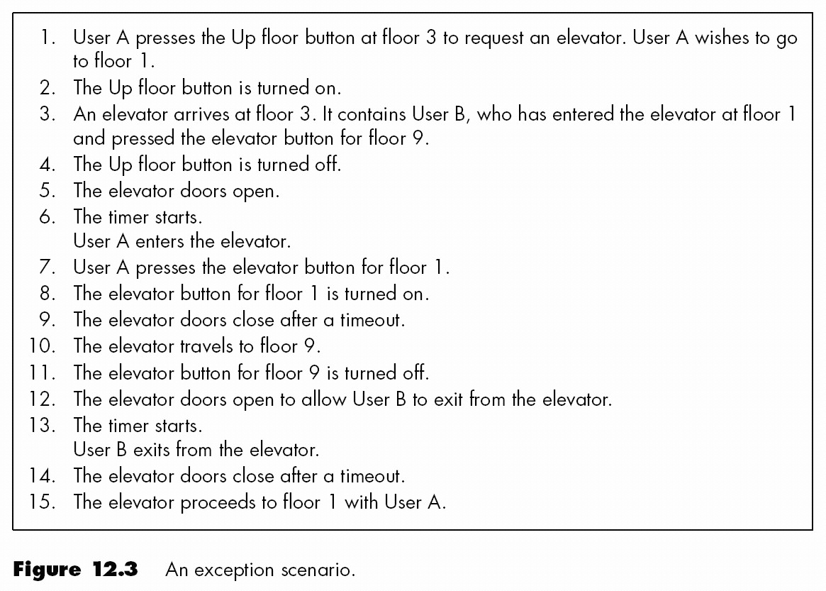
Exception Scenario

Slide 26
Class Modeling
Extract classes and their attributes
Represent them diagramusing an entity-relationship
Deduce the classes from use cases and their scenarios
Often there are many scenarios
Possible danger: too many candidate classes

Slide 27
Two Approaches to Class Modeling
Noun extraction
Always works
CRC classes
Need to have domain expertise

Slide 28
Noun Extraction
Stage 1. Concise Problem Definition
Define product in single sentence
Buttons in elevators and on the floors control the motion of n elevators in a building with m floors.

Slide 29
Noun Extraction (contd)
Stage 2. Informal Strategy
Incorporate constraints, express result in a single paragraph
Buttons in elevators and on the floors control movement of n elevators in a building with m floors. Buttons illuminate when pressed to request the elevator to stop at a specific floor; illumination is canceled when the request has been satisfied. When an elevator has no requests, it remains at its current floor with its doors closed.

Slide 30
Noun Extraction (contd)
Stage 3. Formalize the Strategy
Identify nouns in informal strategy. Use nouns as candidate classes
Nouns
button, elevator, floor, movement, building, illumination, illumination, door
floor, building, door are outside problem boundary — exclude
movement, illumination are abstract nouns — exclude (may become attributes)
Candidate classes: Elevator and Button
Subclasses: Elevator Button and Floor Button

Slide 31
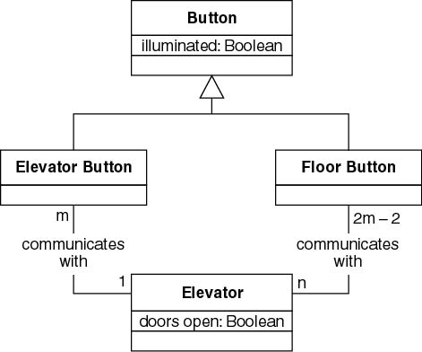
First Iteration of Class Diagram
Problem
Buttons do not communicate directly with elevators
We need an additional class: Elevator Controller

Slide 32
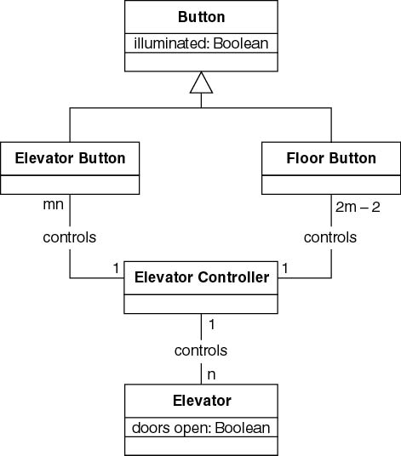
Second Iteration of Class Diagram
All relationships are now 1-to-n
Makes design and implementation easier

Slide 33
CRC Cards
Used since 1989 for OOA
For each class, fill in card showing
Name of class
Functionality (responsibility)
List of classes it invokes (collaboration)
Now automated (CASE tool component)
Strength
When acted out by team members, powerful tool for highlighting missing or incorrect items
Weakness
Domain expertise is needed

Slide 34
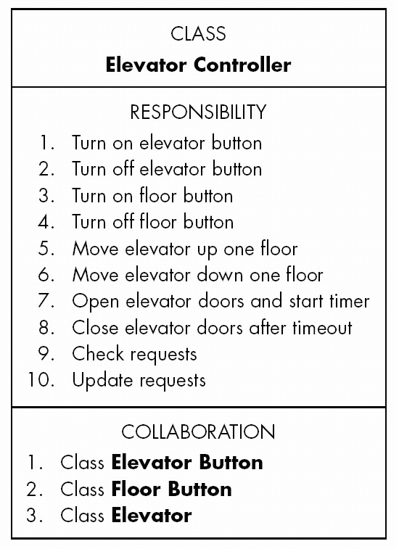
Testing during the OOA Phase
CRC cards are an excellent testing technique

Slide 35
CRC Cards
Consider responsibility
1. Turn on elevator button
Totally unacceptable for object-oriented paradigm
Responsibility-driven design ignored
Information hiding ignored
Responsibility
1. Turn on elevator button
should be
1. Send message to Elevator Button to turn itself on

Slide 36
CRC Cards (contd)
A class has been overlooked
Elevator doors have a state that changes during execution (class characteristic)
Add class Elevator Doors
Safety considerations
Reconsider class model
Then reconsider dynamic model, use-case model

Slide 37
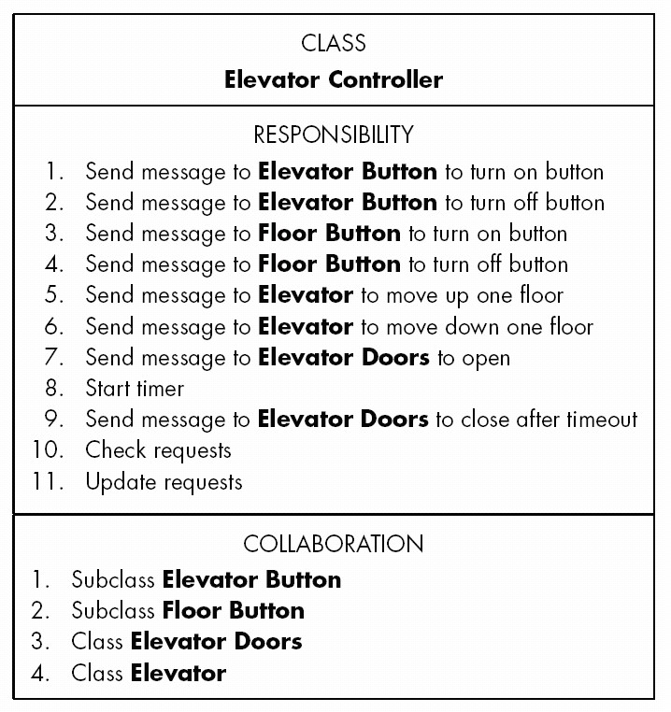
Second Iteration of CRC Card

Slide 38
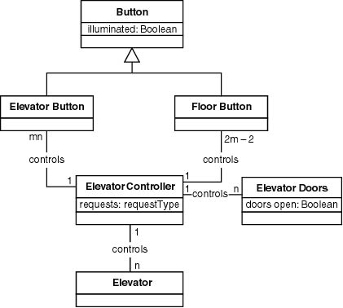
Third Iteration of Class Diagram

Slide 39
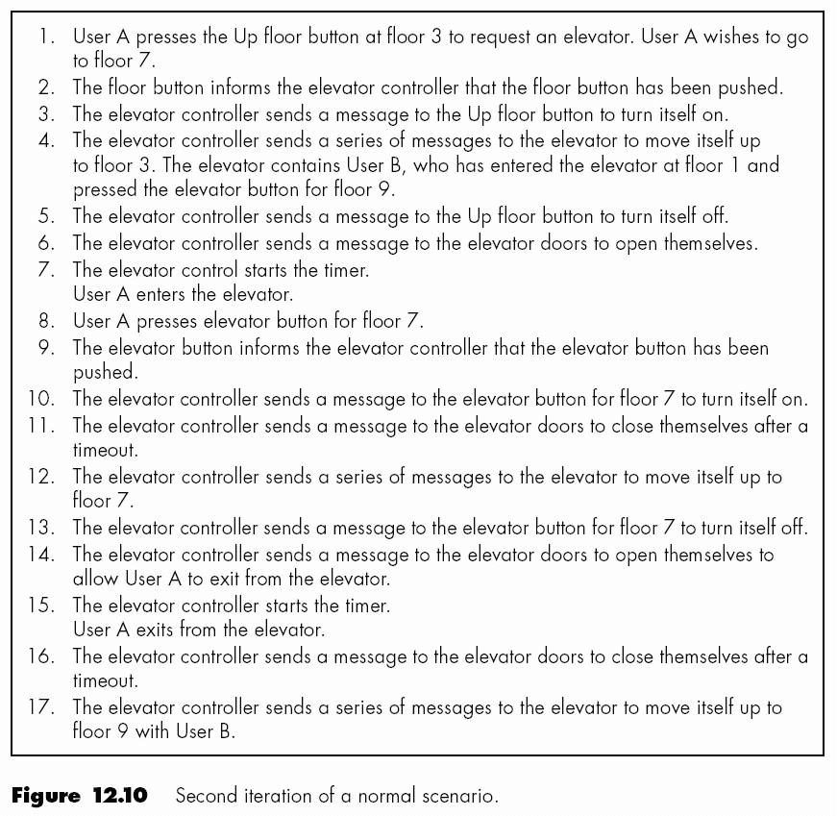
Second Iteration of Normal Scenario

Slide 40
Challenges of the OOA Phase
Do not be eager to jump into object-oriented design
Do not allocate methods to classes yet

Slide 41
DESIGN PHASE

Slide 42
Overview
Elevator problem: object-oriented design

Slide 43
Object-Oriented Design (OOD)
Aim
Design product in terms of objects extracted during OOA

Slide 44
Object-Oriented Design Steps
OOD consists of four steps:
1. Construct interaction diagrams for each scenario
2. Construct the detailed class diagram
3. Design the product in terms of clients of objects
4. Proceed to the detailed design

Slide 45
Elevator Problem: OOD
Step 1. Construct interaction diagrams for each scenario
Sequence diagrams
Collaboration diagrams
Both show the same thing
Objects and messages passed between them
But in a different way

Slide 46
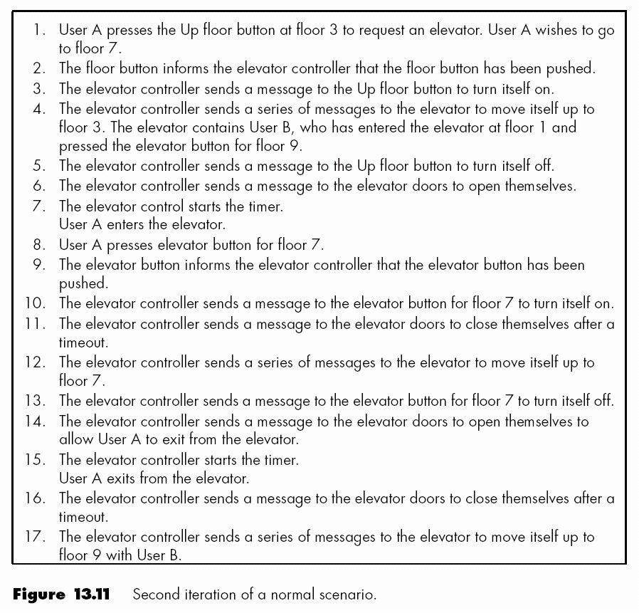
Elevator Problem: OOD (contd)
Normal scenario

Slide 47
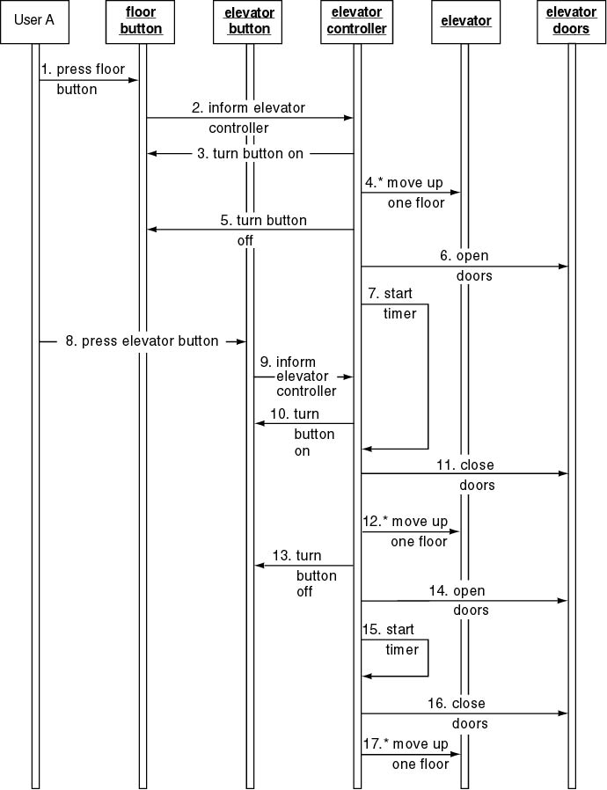
Elevator Problem: OOD (contd)
Sequence diagram

Slide 48
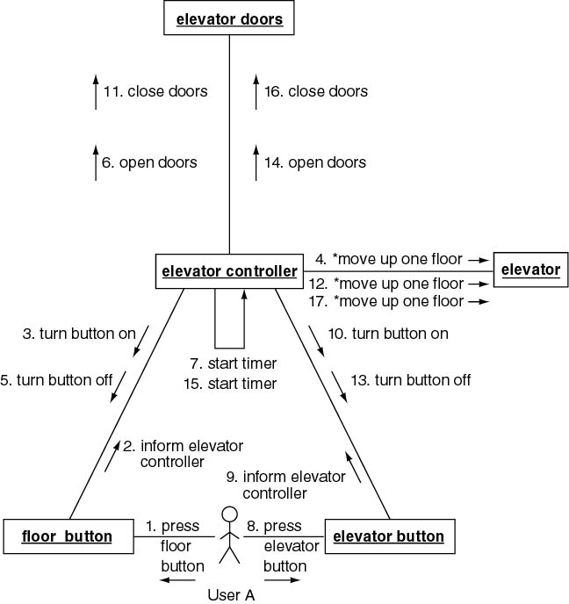
Collaboration diagram

Slide 49
Elevator Problem: OOD (contd)
Step 2. Construct Detailed Class Diagram
Do we assign an action to a class or to a client of that class?
Criteria
Information hiding
Responsibility-driven design
Examples
close doors is assigned to Elevator Doors
move one floor down is assigned to Elevator

Slide 50
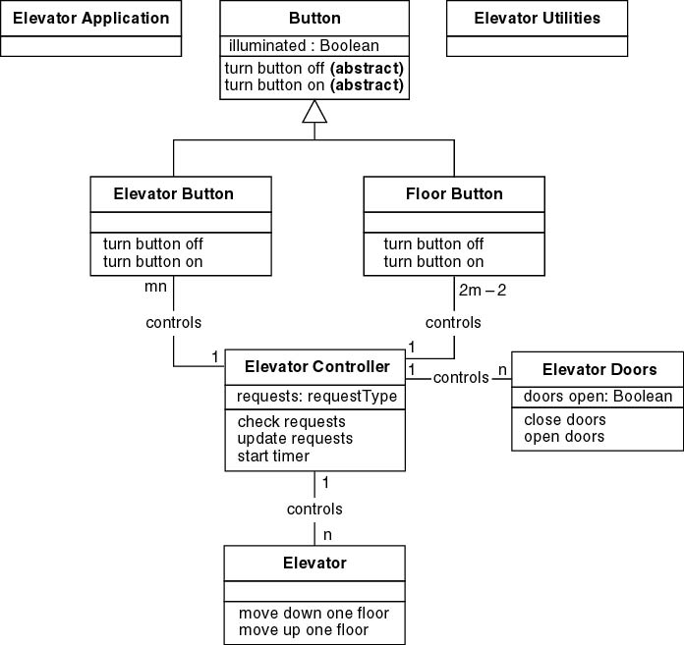
Elevator Problem: OOD (contd)
Detailed class diagram

Slide 51
Elevator Problem: OOD (contd)
Step 3. Design product in terms of clients of objects
Draw an arrow from an object to a client of that object
Objects that are not clients of any object have to be initiated, probably by the main method
Additional methods may be needed

Slide 52
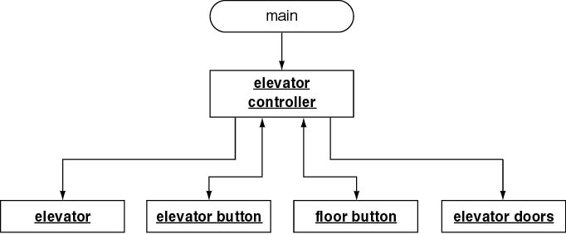
Elevator Problem: OOD (contd)
C++ Client-object relations

Slide 53
Elevator Problem: OOD (contd)
elevator controller needs method elevator control loop so that main (or elevator application) can call it

Slide 54
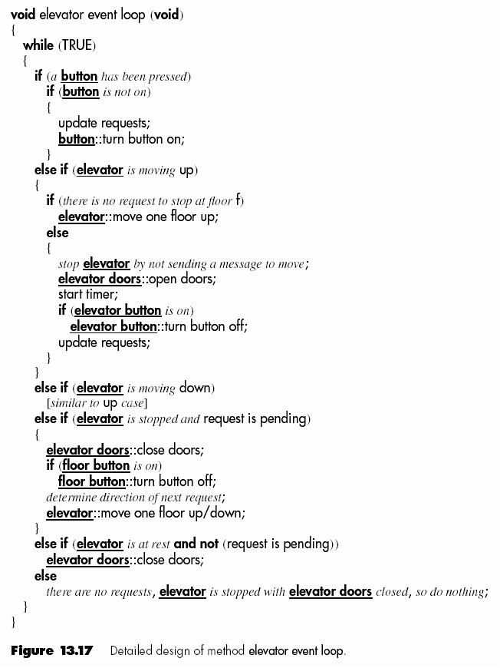
Elevator Problem: OOD (contd)
Step 4. Perform detailed design
Detailed design of method elevator controller loop

Slide 55
Challenges of the Design Phase
Design team should not do too much
Detailed design should not become code
Design team should not do too little
It is essential for the design team to produce a complete detailed design

Slide 56
Rational Software Architect - Wikipedia

